Slide 1
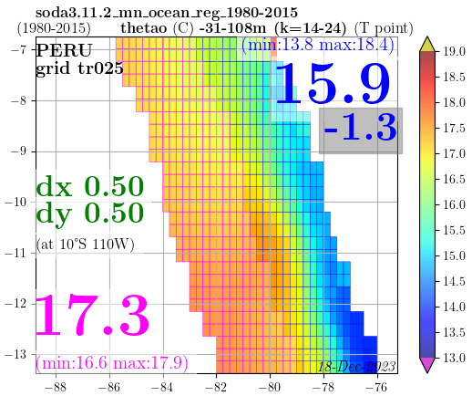
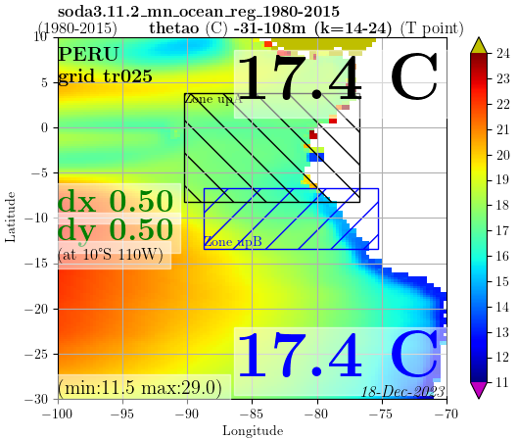
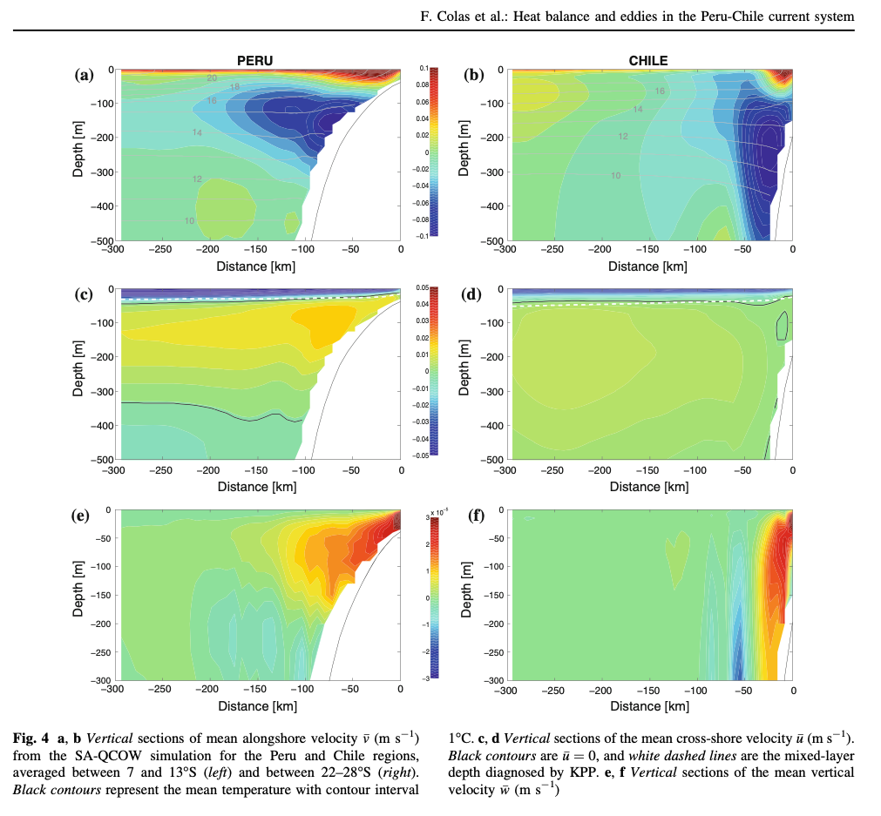
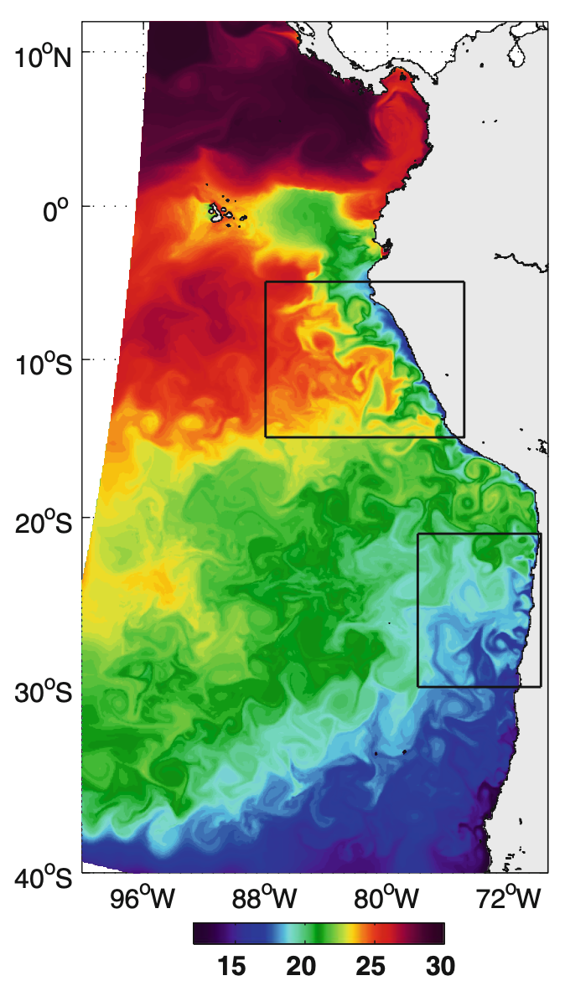
7°S
~7°S
~13°S
13°S
~3° / 300 km
~3° / 300 km
~14° / 1400 km
~7°S
(vertical sections
averaged between
7 and 13°S)
white dashed lines:
MLD diagnosed by KPP
~30,40m
~13°S ?
~3° / 300 km
W
W
14° / ~ 1.400 km

